Slide 1
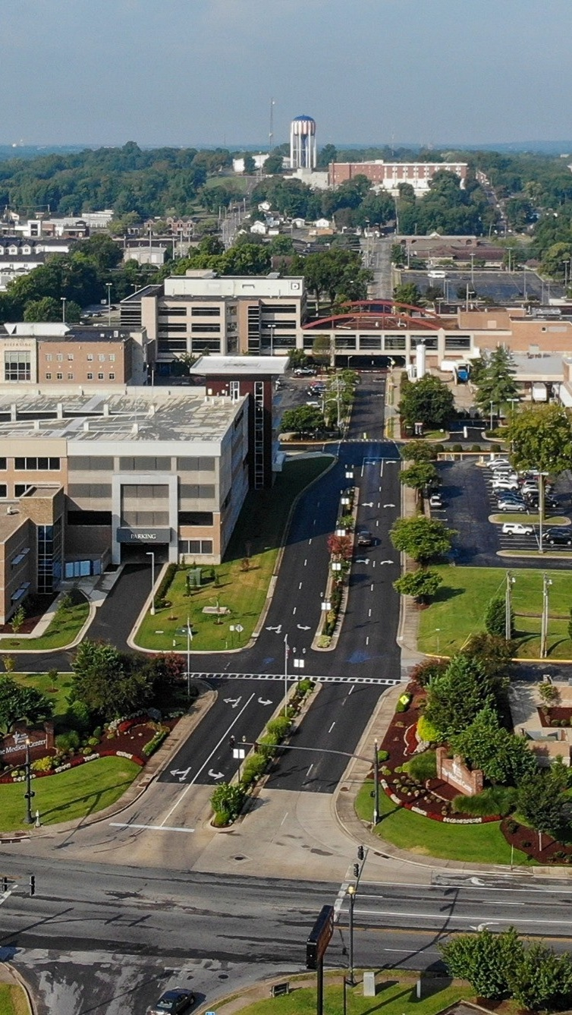
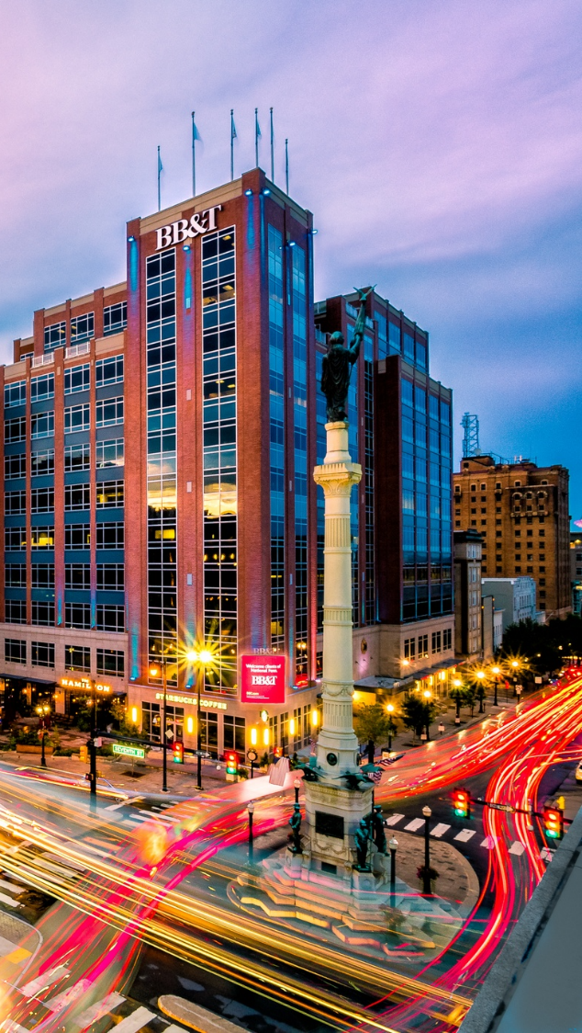

OPPORTUNITY REVIEW
DIRECT-TO-EMPLOYER GTM STRATEGY
Exploring a Med Center Health DTE Health Plan

Slide 2


Founded in 1979, headquartered in Indianapolis
Largest Independently-Owned Full-Service Third-Party Administrator
Specialize in Administration of Self-Funded Plans and Population Health Management​
Leader in the Direct-to-Employer Movement
We Know and Understand the Market
Experience Working with All Professional Teams: Agents, Networks, MGAs
The Key Family of Companies is a Vertically Integrated group of benefit related organizations
3,000+ Corporate Clients
3 Million Members under Management
700 Employees

Slide 3
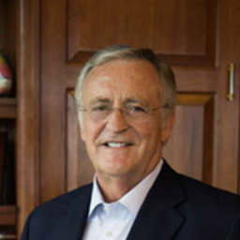


Our Founding and Heritage: 46 Years of Striving for Honesty in Healthcare

Slide 4
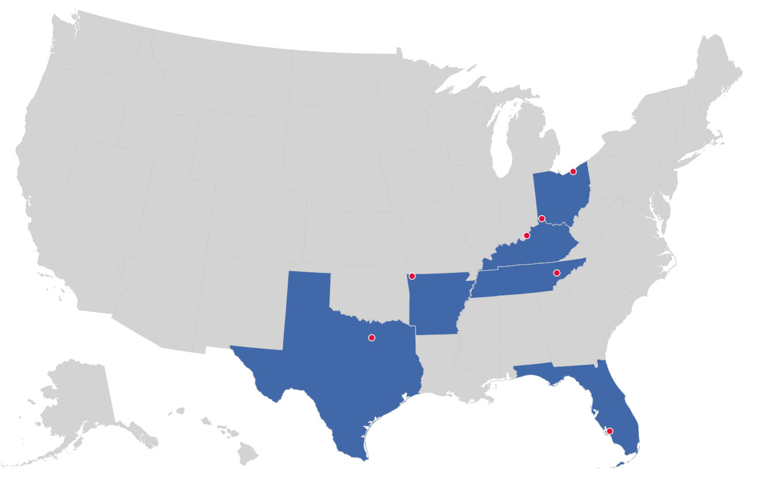

MARKET LEADER
IN
PRIVATE LABELED
DTE PLANS
Cleveland, OH
Louisville, KY
Cincinnati, OH
Bentonville, AR
Knoxville, TN
Dallas Fort Worth, TX
Fort Myers, FL

Slide 5
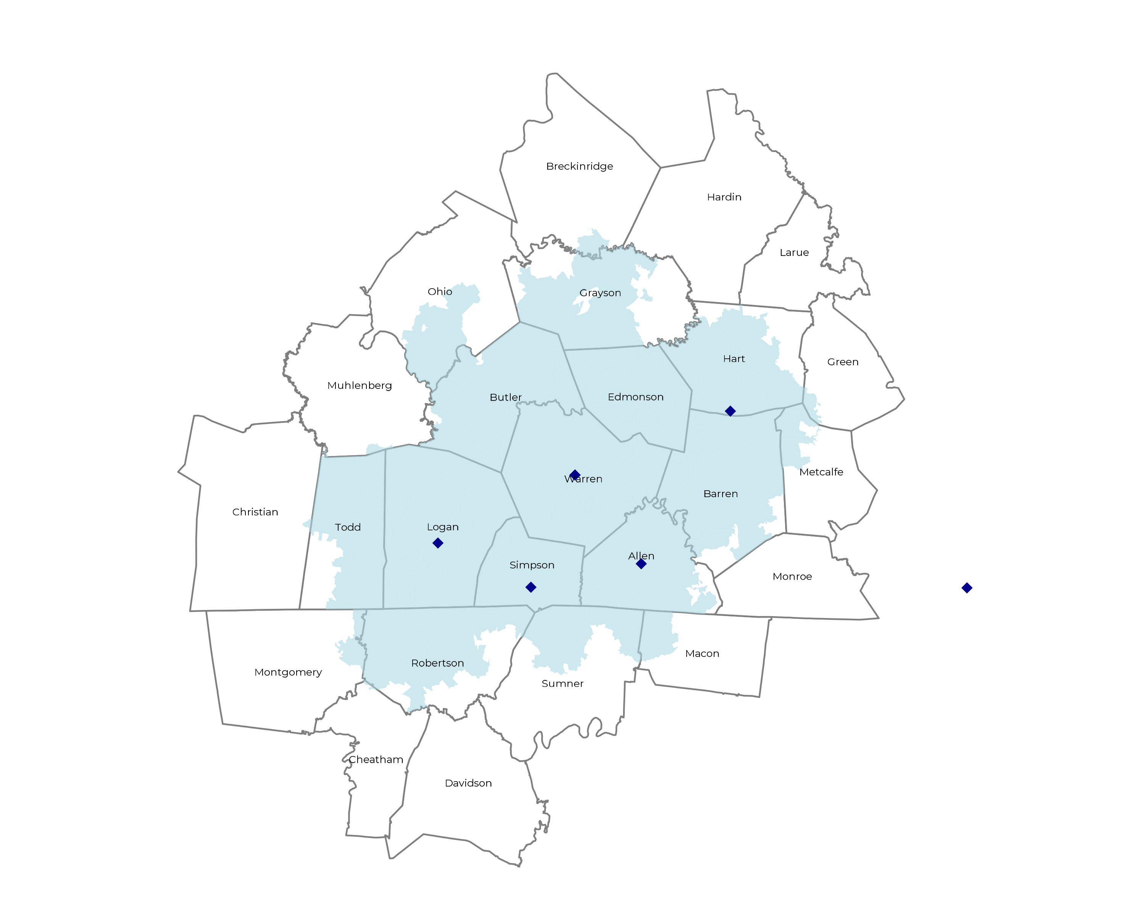
SIGNIFICANT OPPORTUNITY FOR PLAN GROWTH Researched for the below highlighted service area
Target Market 250+ Employers 60,000+ Employees 120,000+ Members
 | Employer Size Group (# of Employees)
Commercial Employers With Headquarters | 50-100 | 101-200 | 201-400 | 401-1,000 | 1,001-3,000 | 3,000+
In Catchment Area | 134 | 54 | 39 | 26 | 9 | 3
Total Employees at Employers | 50-100 | 101-200 | 201-400 | 401-1,000 | 1,001-3,000 | 3,000+
Headquartered in Catchment Area | 10,100 | 8,100 | 11,700 | 18,200 | 18,000 | 18,000
Total Members with Employers | 50-100 | 101-200 | 201-400 | 401-1,000 | 1,001-3,000 | 3,000+
Headquartered in Catchment Area | 18,200 | 14,600 | 21,100 | 32,800 | 32,400 | 32,400

Slide 6
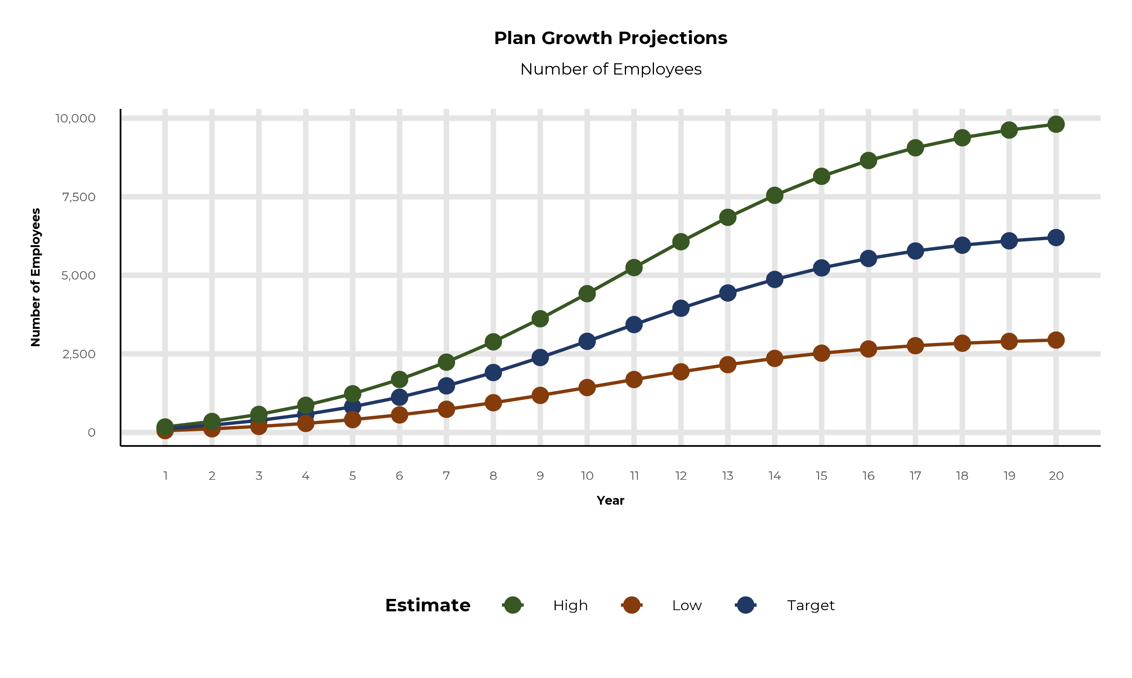
PLAN POTENTIAL GROWTH PATHS
Self Funded
85K
Insured
146K
Working Age
234K
Population
398K
Estimates includes the Med Center Health service area in Allen, Barren, Butler, Edmonson, Grayson, Hart, Logan, Metcalfe, Ohio, Simpson, Todd, Warren, Montgomery, Robertson, and Sumner Counties

Slide 7
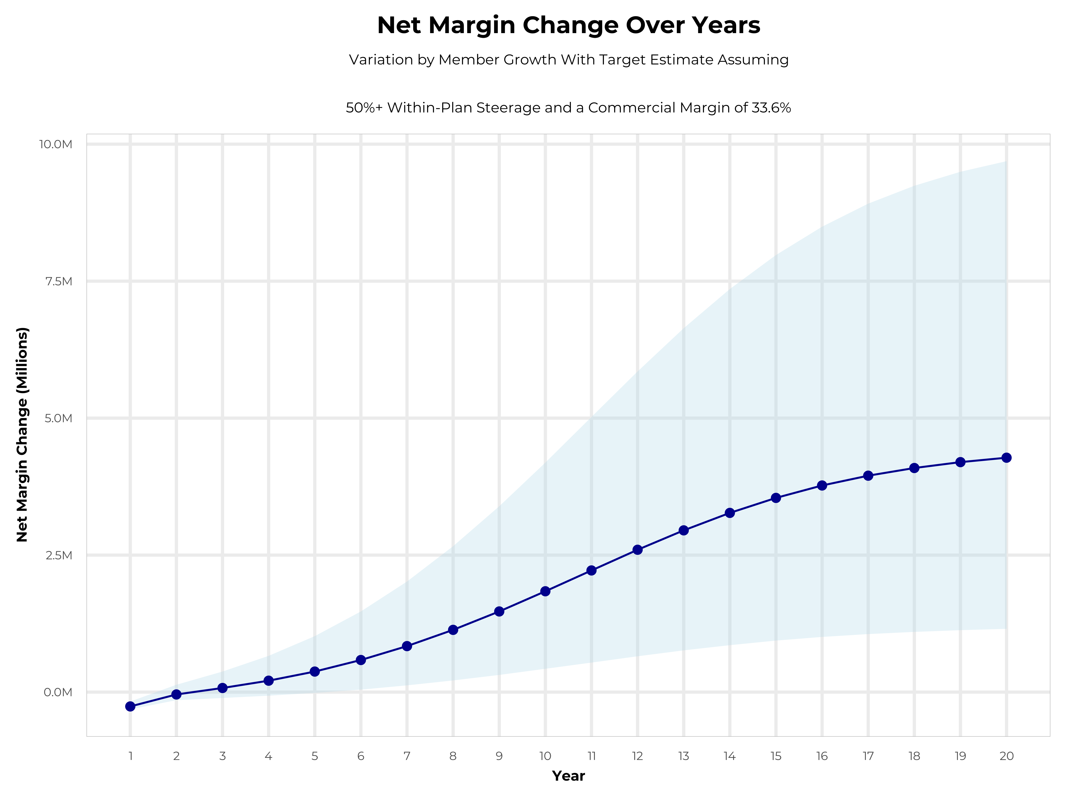
GROWING POWERFUL, LASTING PROFITABILITY
Early Stage
Gaining Name Recognition, Early Growth
New Revenue:
New Profit:
$1.04M
$0.16M
Growth Stage
Strong Reputation, Strong Growth
New Revenue:
New Profit:
$5.88M
$1.87M
Mature Stage
High Profitability, Market Saturation
New Revenue:
New Profit:
$11.65M
$3.87M

Slide 8
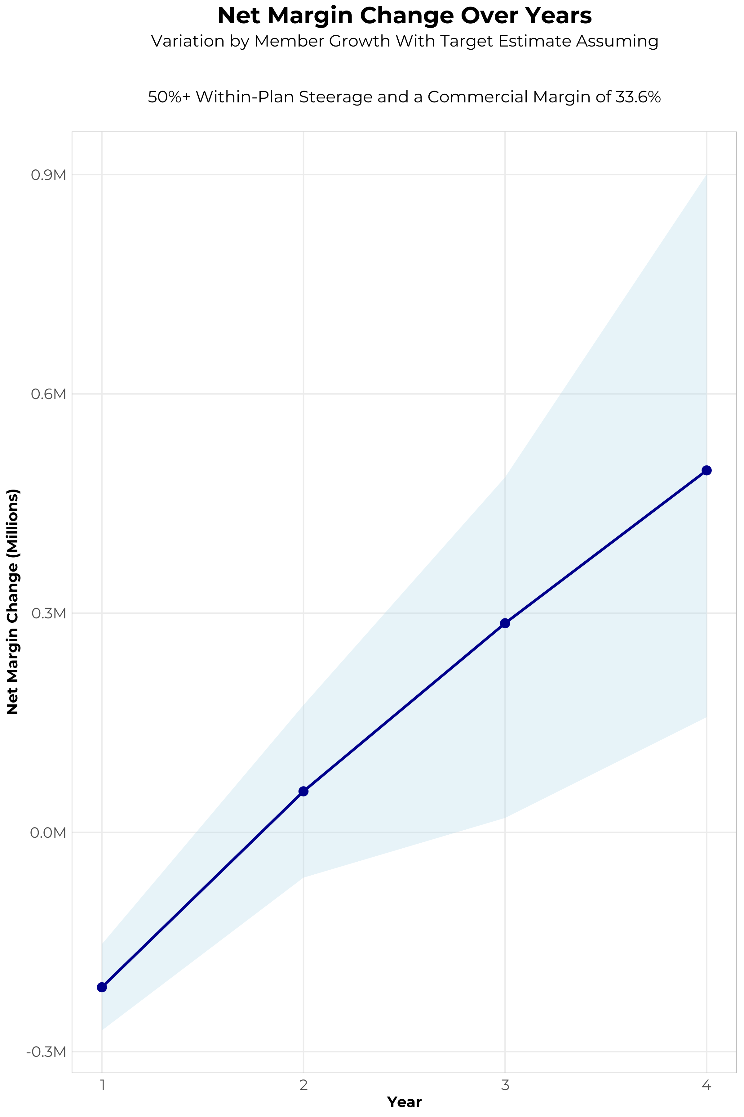
FOUR-YEAR PROJECTIONS
Target Member Growth | Target Member Growth | Target Member Growth | Target Member Growth | Target Member Growth
Metric | Year 1 | Year 2 | Year 3 | Year 4
Number of Members | 200 | 400 | 700 | 1,000
Incremental Margin | 115.7K | 231.4K | 457.8K | 663.3K
Network Access Fee | 2.4K | 4.8K | 8.4K | 12.0K
Implementation Fee (One-Time) | -150.0K | 0.0K | 0.0K | 0.0K
Sales and Marketing Costs | -180.0K | -180.0K | -180.0K | -180.0K
Net Margin Change | -211.9K | 56.2K | 286.2K | 495.3K
High Member Growth | High Member Growth | High Member Growth | High Member Growth | High Member Growth
Metric | Year 1 | Year 2 | Year 3 | Year 4
Number of Members | 300 | 600 | 1,000 | 1,600
Incremental Margin | 173.5K | 347.0K | 653.9K | 1,061.3K
Network Access Fee | 3.6K | 7.2K | 12.0K | 19.2K
Implementation Fee (One-Time) | -150.0K | 0.0K | 0.0K | 0.0K
Sales and Marketing Costs | -180.0K | -180.0K | -180.0K | -180.0K
Net Margin Change | -152.9K | 174.2K | 485.9K | 900.5K
Low Member Growth | Low Member Growth | Low Member Growth | Low Member Growth | Low Member Growth
Metric | Year 1 | Year 2 | Year 3 | Year 4
Number of Members | 100 | 200 | 300 | 500
Incremental Margin | 57.8K | 115.7K | 196.2K | 331.6K
Network Access Fee | 1.2K | 2.4K | 3.6K | 6.0K
Implementation Fee (One-Time) | -150.0K | 0.0K | 0.0K | 0.0K
Sales and Marketing Costs | -180.0K | -180.0K | -180.0K | -180.0K
Net Margin Change | -271.0K | -61.9K | 19.8K | 157.6K

Slide 9

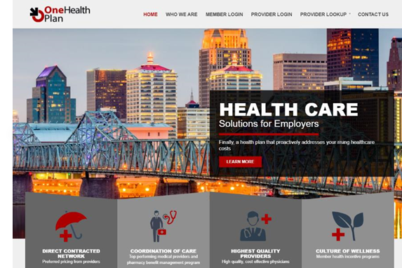
Complete Marketing System
Customized Branding and Messaging
Customized Brochures
Customized Web Site
Targeted Employer Outreach
Sales System (Social Media, Email, Text, etc.)

Slide 10
PROJECTED PLAN GROWTH
Year | Employees | Members | Percent of Members Choosing Med Center Health for Inpatient Care | Percent of Members Choosing Med Center Health for Outpatient Care
1 | 100 | 200 | 77% | 70%
2 | 200 | 400 | 77% | 70%
3 | 400 | 700 | 77% | 73%
4 | 600 | 1,100 | 77% | 74%
5 | 800 | 1,400 | 77% | 74%
6 | 1,100 | 2,000 | 77% | 74%
7 | 1,500 | 2,700 | 77% | 74%
8 | 1,900 | 3,400 | 77% | 74%
9 | 2,400 | 4,300 | 77% | 74%
10 | 2,900 | 5,200 | 77% | 75%
11 | 3,400 | 6,100 | 77% | 75%
12 | 4,000 | 7,200 | 77% | 75%
13 | 4,400 | 7,900 | 77% | 75%
14 | 4,900 | 8,800 | 77% | 75%
15 | 5,200 | 9,400 | 77% | 75%
16 | 5,500 | 9,900 | 77% | 75%
17 | 5,800 | 10,400 | 77% | 75%
18 | 6,000 | 10,800 | 77% | 75%
19 | 6,100 | 11,000 | 77% | 75%
20 | 6,200 | 11,200 | 77% | 76%
KBA currently estimates that Med Center Health has 70% inpatient market share, and 50% outpatient market compared to hospitals/clinics in the Med Center Health service area (see slide 8).
Based on previous DTE experience, KBA expects a significant bump in patient steerage to Med Center Health.
Additional steerage will occur from additional steerage patient benefits and the patient convenience card.
High estimates start nearly 10% higher than target with low estimates at 10% lower than target

Slide 11
YEAR 4 PROJECTED REVENUE AND PROFIT
Pre-DTE Cohort of 1,000 Employees | Inpatient | Outpatient | Professional | Total
Revenue† | $ 1,928,560 | $ 2,504,403 | $ 1,169,535 | $ 5,602,497
Net Income‡ | $ 647,996.1 | $ 841,479.3 | $ 392,963.7 | $ 1,882,439
† Assuming proportional revenues from market shares of 70% (inpatient) and 50% (outpatient)
‡ Conservatively assuming a commercial margin of 33.6% (80% of the estimated commercial margin)
With DTE | Inpatient | Outpatient | Professional | Total
Revenue⁰ | $ 2,122,614 | $ 3,693,449 | $ 1,724,809 | $ 7,540,872
Net Income* | $ 713,198.2 | $ 1,240,999 | $ 579,536 | $ 2,533,733
⁰ Assuming 77% inpatient and 74% market steerage based on KBA narrow network DTE experience (see previous slide)
* Conservatively assuming a commercial margin of 33.6%, with a 10 percentage-point reduction to reflect competitive-edge rates and a 10 percentage-point increase due to lower billing costs and higher patient responsibility collections because of the member convenience card.
Total Increase in Net Income | $ 651,294.1
Network Access Fee (Revenue) of $1 PMPM | $ 12,000
Total Profit Growth | $ 663,294.1
Minus Implementation Fee (One-Time) | -$ 0
Minus Sales and Marketing (Annual – Ongoing) | -$ 180,000
Total | $ 483,294.1

Slide 12

A PARTNER YOU CAN TRUST
OUR OBJECTIVES ARE ALIGNED
WE KNOW THE
MARKET
COMPLETELY TRANSPARENT
WE HAVE THE SOPHISTICATION AND INFRASTRUCTURE TO EFFECTIVELY COMPETE
Derek Moore, Senior Vice President – KBA
845-283-9973 * derek.moore@keybenefit.com

